Slide 1
Significant figures
Significant figures are the meaningful digits in a measured
or calculated quantity.

Slide 2
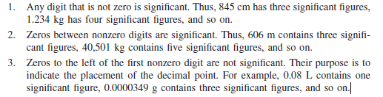
Rules of significant figures

Slide 3
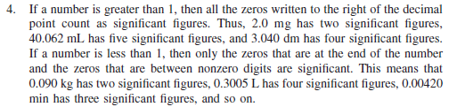

Slide 4
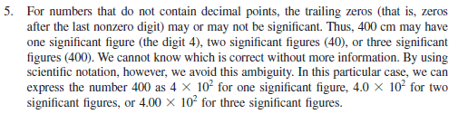

Slide 5
Rounding-off
Always round to the even number, if the last digit is 5
8.65 = 8.6
8.75 = 8.8
8.55 = 8.6

Slide 6
Rounding-off
If the digit is less than 5, simply drop it and all digits farther
to the right.
Example:
8.724 rounds off to 8.72 if we want only two digits after the
decimal point
Rounding 1.2143 to three significant figures gives 1.21

Slide 7
2. If the first digit following the point of rounding off is
greater than 5, we add 1 to the preceding digit.
Example:
8.727 rounding off to 8.73
0.425 rounds off to 0.42
Rounding off 1.2151 to three significant figures gives 1.22
9.47 = 9.5

